Slide 1
Senator Royce Duplessis’ Proposed SB356:
Real-time Fenceline Monitoring/Alert Systems
Vickie Boothe, Environmental Engineer/Epidemiologist
Climate Reality Project Greater New Orleans Chapter
Acknowledgement: Real-time Fenceline Monitoring Technical Team
Vickie Boothe, Rosane Archery-McGowan, Greg Gasperecz, Scott Eustis
Notes:
This presentation describes Senator Duplessis’s proposed SB356 which requires 117 LA facilities to install real-time fenceline monitoring and alert systems

Slide 2
What is Real-time fenceline Air Monitoring?
2
Notes:
I’m going to begin with a few basic definitions starting with what is real-time fenceline monitoring?

Slide 3
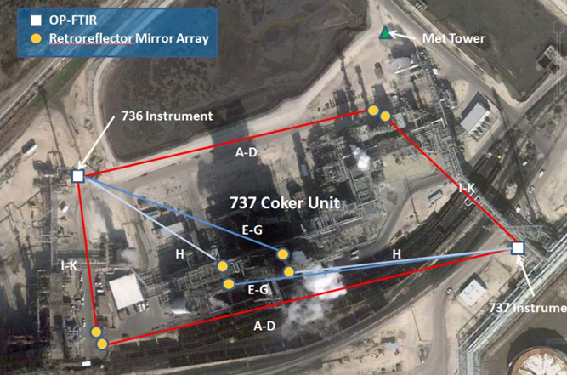
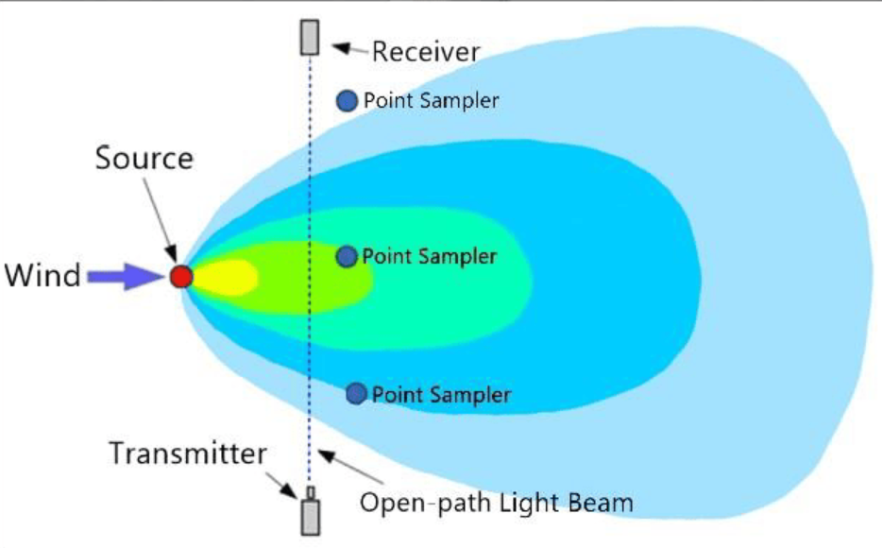
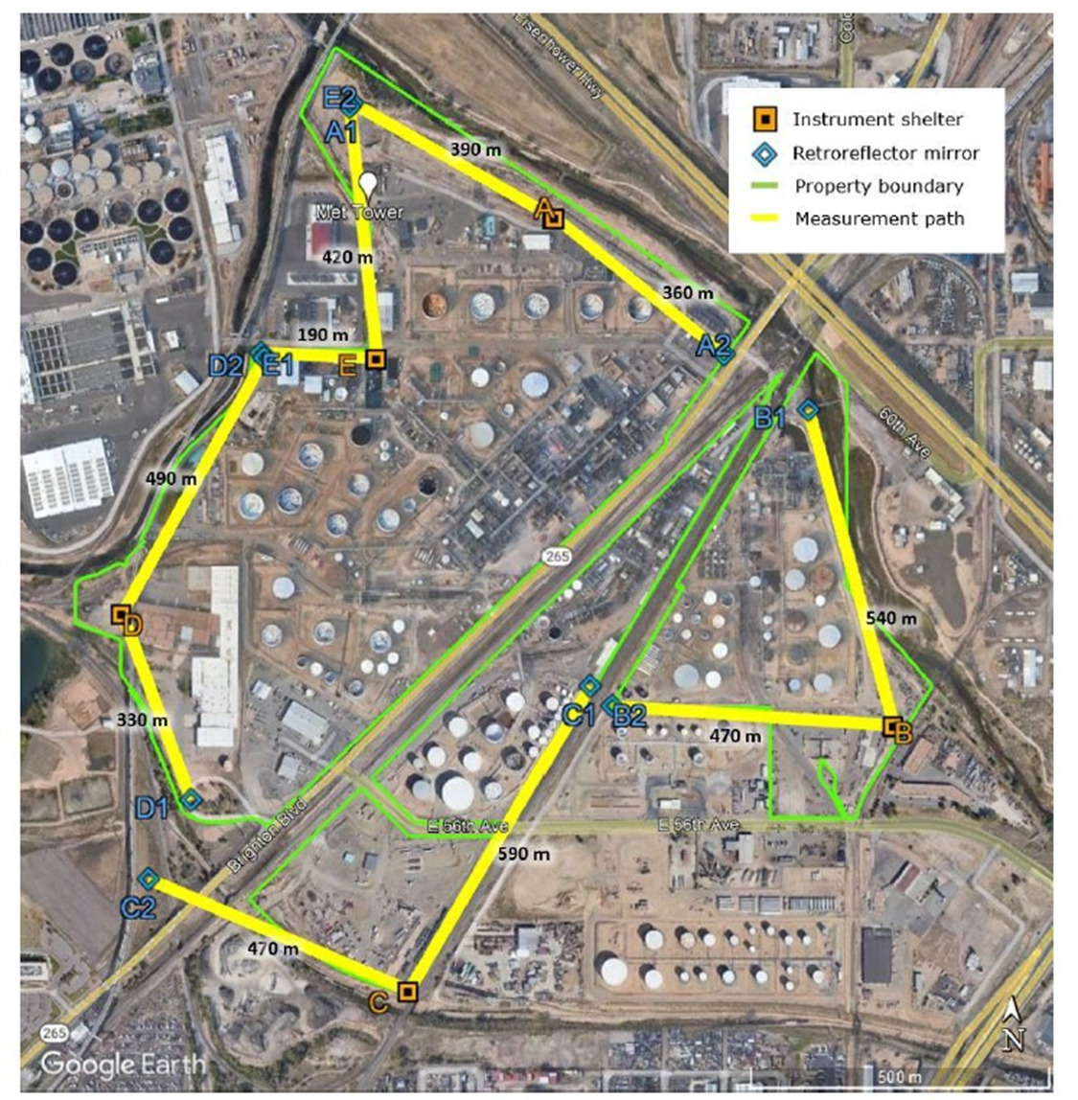
SB356 Real-time Fenceline Monitoring Definition
Equipment that continuously measures, records, and reports in real-time toxic air pollutant concentrations [ground-level fugitive emissions] at or near a facility's property boundary, and that provides coverage of the entire boundary of the facility.
3
Notes:
READ Definition. Theses pictures show 2 facility system examples. The middle figure depicts how concentrations of fugitive emissions passing through the open-path light beam are detected, identified, and recorded

Slide 4
What are fugitive emissions?
4

Slide 5
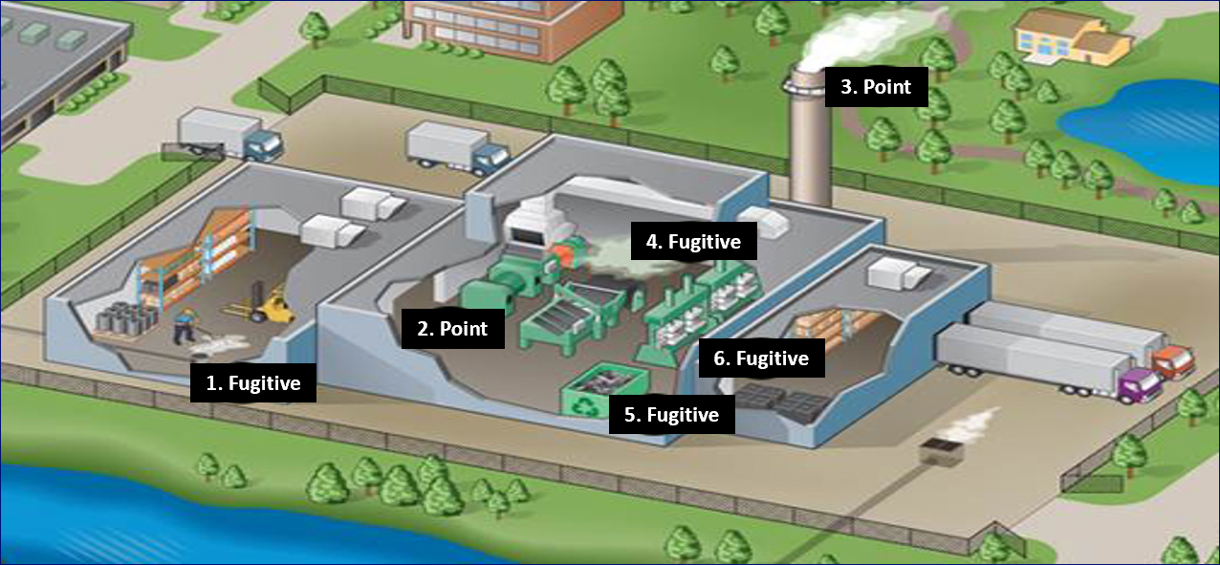
Rubber Manufacturer Fugitive vs Point Emissions
Fugitive Emissions
  Raw Material Storage
  Rubber Cutting
  Rubber Curing
  Packaging/Loading
Point Emissions
  Captured/Controlled Mixing
  Released Non-Captured Mixing (<2%)
Note: In 2015, EPA determined 85% of all refinery benzene emissions resulted from uncontrolled, ground-level fugitive sources.
5
Notes:
This figure illustrates the type of emissions created at a Rubber Manufacturing Facility. As shown, in Step1, raw feedstock and catalyst chemical are trucked in, unloaded and stored. Fugitive emissions are created when the raw material packaging is opened or the materials are accidently spilled. In Step 2, the raw feedstock and chemical are transferred into a tightly enclosed chamber where they are mixed under high heat and pressure under a powerful fume hood which is required to collect at least 98% of the created gases and route them to a control device. Step 3 shows the release of the remaining 2% of gases from a tall smokestack. Steps 2 & 3 are defined as controlled “Point” emissions. Additional fugitive emissions are created in Steps 3, where large sheets of rubber are cut into smaller pieces, then in Step 4, the pieces are transferred for curing under low heat and pressure, and the finally in Step 5, the cured rubber products are packaged for transport. For decades, EPA regulators believed the amount of fugitive emissions were relatively small compared to the controlled Point emissions. That belief was shattered in 2015 after EPA determined 85% of all refinery benzene emissions resulted from uncontrolled, ground-level fugitive sources.

Slide 6
SB356 covered Facilities/pollutants
6

Slide 7
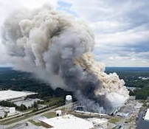
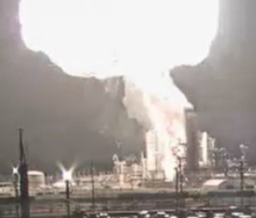
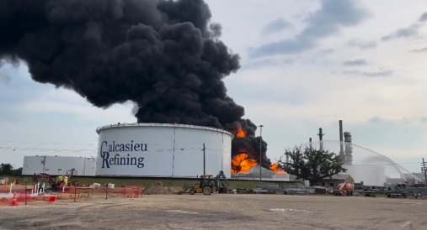
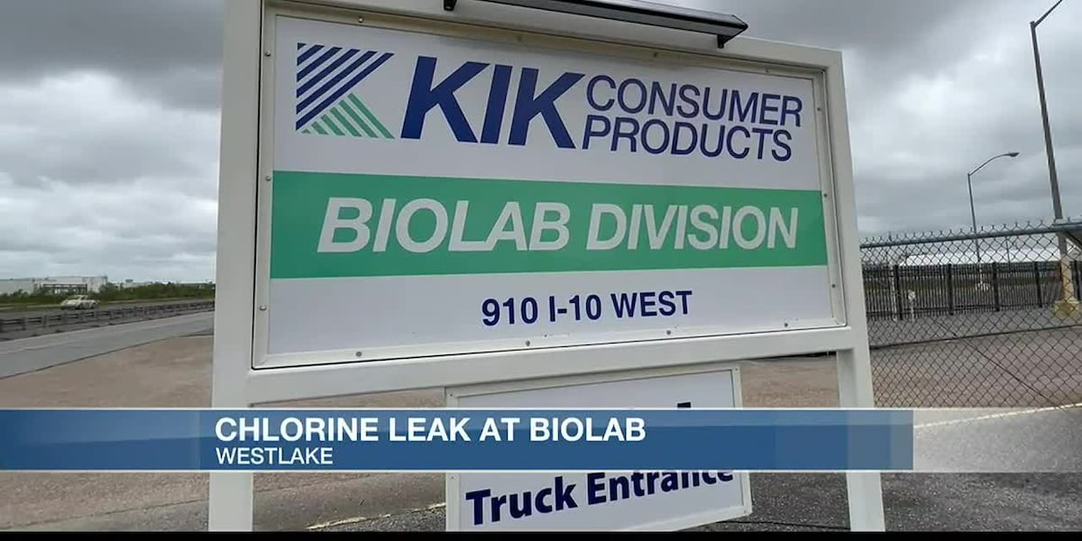
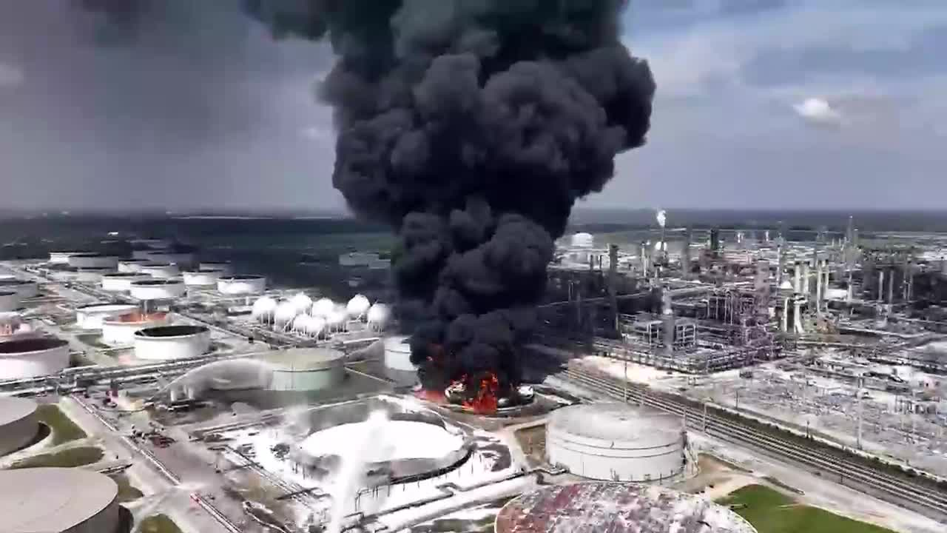
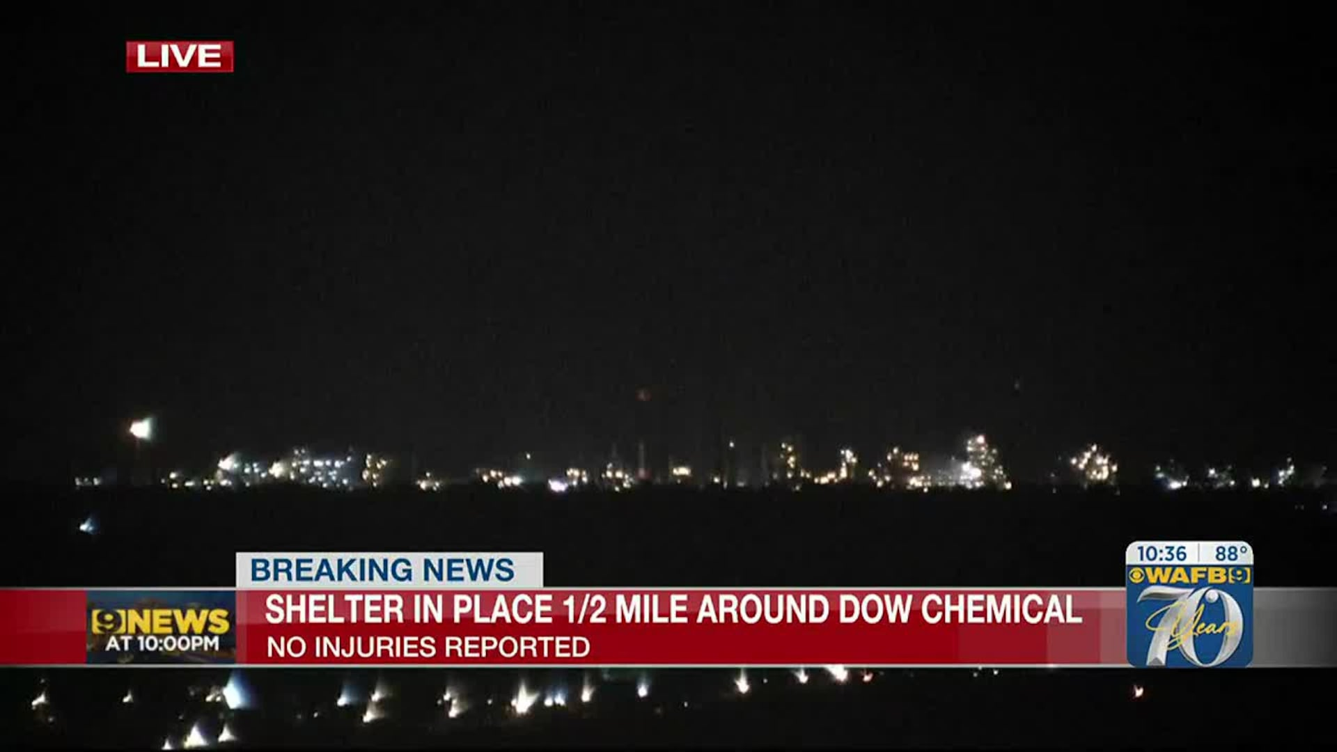
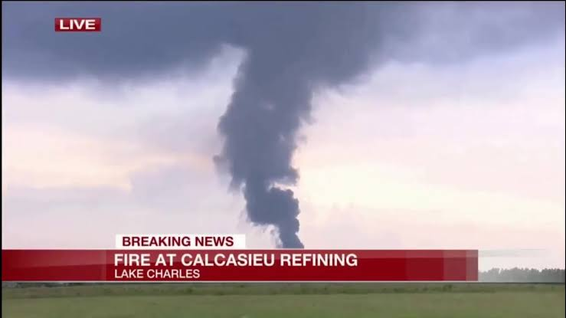
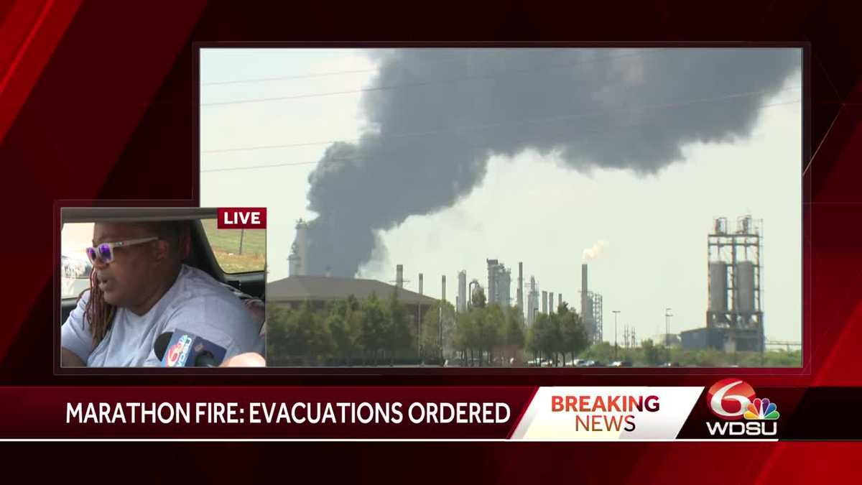
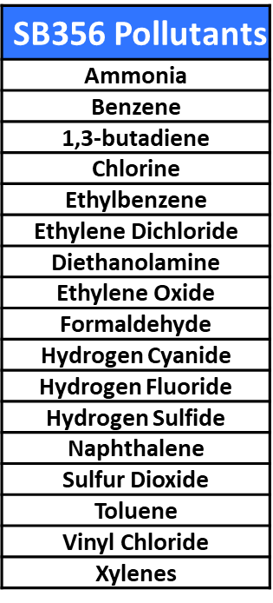
SB356 Covered Facilities & Pollutants
117 Highest Risk Facilities
  99 Chemical Manufacturing
  18 Petroleum Refineries
17 Most Toxic Pollutants
  Highest Toxicity-weighted Risk Drivers
  Most Frequent Accidentally Released
7
Notes:
Here are the lists of 117 proposed covered highest risk facilities and 17 most toxic pollutant. The covered 117 facilities include 99 large chemical manufacturers and18 petroleum refineries.

Slide 8
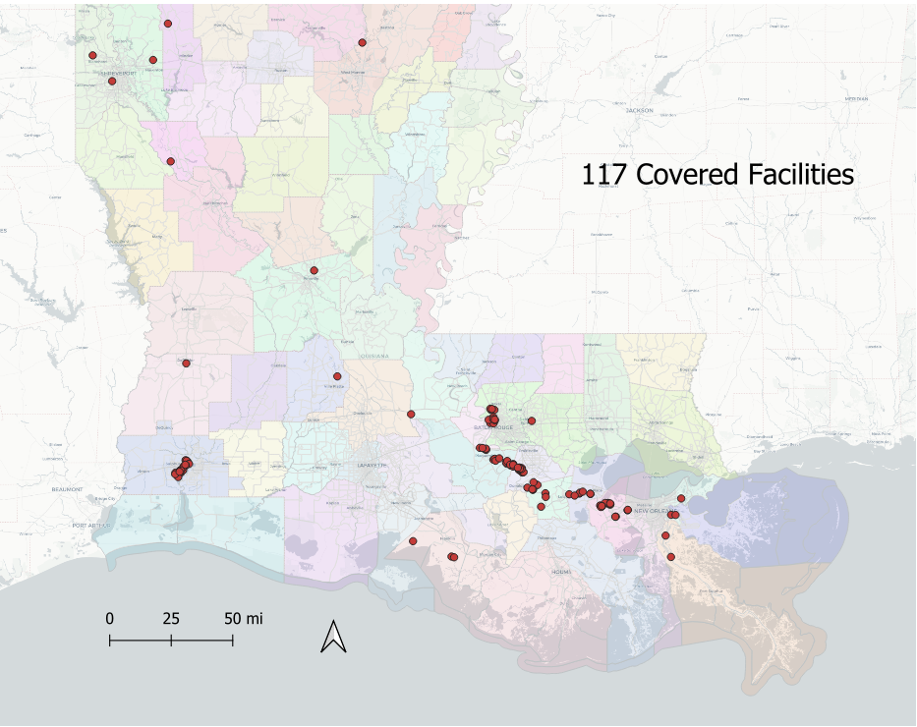
Geographic Distribution of Covered Facilities
Map Prepared by Scott Eustis, Healthy Gulf
8

Slide 9
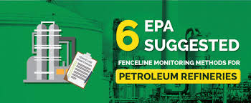
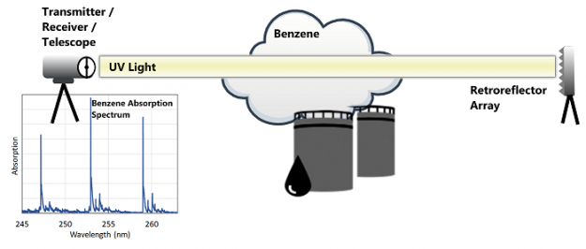

Real-time Fenceline Monitoring/Alert System Costs
EPA-Recommended Open Path Monitors
  Measures up to 100 pollutants at lengths 500 – 1000m (1640 - 3280ft)*
  Average Costs $250,000 - $630,000 Capital, $25,000 Annual**
    4 - 10 monitors & equipment shelters, data logger, weather station
Data Platform/Website
  Collects, analyzes, & stores real-time data
  Creates real-time & historical data visualizations
    Graphs, maps, tables
  Costs: $2,000 - $3,500/facility Capital, $40,000 Annual**
Automatic Realtime Alerts
  Generated when concentrations exceed health-based thresholds
  Distributed to facility, first responders, local officials, residents
    Opt-in automated texts, emails, or phone calls
*Schill SR et al. Real-World Application of Open-Path UV-DOAS, TDL, and FT-IR Spectroscopy for Air Quality Monitoring at Industrial Facilities. Spectroscopy Supplements. Nov. 1, 2022
* *Mitro T. Santa Barbara APCD Proposed Staff Report for: Rule 364 Refinery Fenceline and Community Air Monitoring. 2020
9
Notes:
This slide describes the average costs of real-time fenceline monitoring and alert systems. As a reminder, required EPA-recommended open-path monitors can simultaneously measure up to 100 pollutants at distances up to 1,000 meters (which is equivalent to the length of 10 football fields). Capital costs for the open path monitors, equipment shelters, data logger, and a weather station range from $250,000 for systems with 4 monitors to around $630,00 for larger facilities requiring up to 10 monitors. Average annual maintenance cost for these open path monitors will total to around $40.000. Capital cost for the design and customization of a monitoring system data platform and website, which will allow user to view real-time and historical data on a user-friendly website will likely cost each facility between $2,000 - $3,500 with annual maintenance costs of up to $40,000. Those costs also include an opt-in alert system which will automatically generate real-time alerts by text, email, or phone call whenever the concentration of any of the 17 covered pollutants exceeds a health-based threshold.

Slide 10
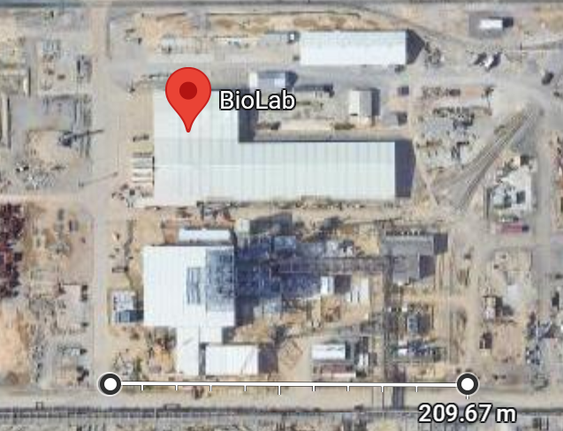
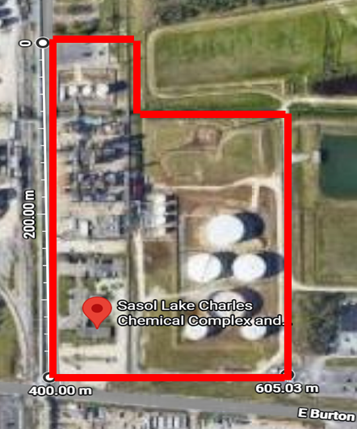
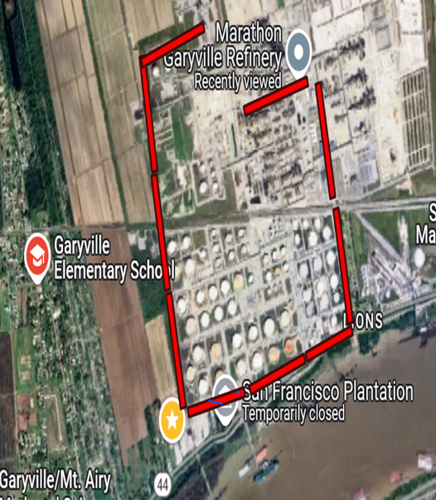

Past Industry Statements vs Actual Fenceline Monitoring Costs
In testimony over Fields' legislation during the past two years, industry representatives have said a new monitoring requirement would affect more than 532 large-scale industrial operations and the monitors would cost industry $500 million to $1.6 billion [$890,000 - $2.8 million/facility] to install.*
BioLab 4 Open Path Monitors, Website, Alerts
$252,000 Capital, $65,000 Annual Maintenance
2023 Earnings: $456.58 million
ITEP Annual Avg: $9.6 million (2.6%)**
Sasol 6 Open Path Monitors, Website, Alerts
$378,500 Capital, $65,000 Annual Maintenance
2025 Earnings: $657 million
ITEP Annual Avg: $1.6 billion (0.03%)**
Marathon 10 Open Path Monitors, Website, Alerts
$628,500 Capital, $65,000 Annual Maintenance
2023 Earnings: 9.7 billion
ITEP Annual Avg: $364 million (0.17%)**
* Aug 17, 2022 Advocate Article by David Mitchell
** Together Louisiana Lost Revenue to ITEP by Parish and Company
10
Notes:
In a 2022 Advocate article, David Mitchell reported that industry representative had testified that previously introduced air monitoring legislation such as the 2023 SB35, would affect >532 facilities, which is more or less true. However, as illustrated by these 3 example facilities, the cited costs of up to $2.8 million/facility appear to be greatly exaggerated. For instance, like many of Louisiana’s chemical manufacturers, BioLab’s system would only require 4 monitors at a capital cost of just over $250,000. Estimated cost for the slightly larger Sasol facility, which would require 6 monitors, is just under $380,000 while the cost for a 10-monitor system for Marathon Garyville, which is the nation’s third largest refinery, would range up to just under $630,000. While these expenses may seem significant, they are relatively minor when compared to the facilities’ annual earnings and industrial tax incentives. As shown at the bottom of the slide, in each case, the real-time monitoring system cost literally represents a rounding error of the facility’s annual property tax exemption.

Slide 11
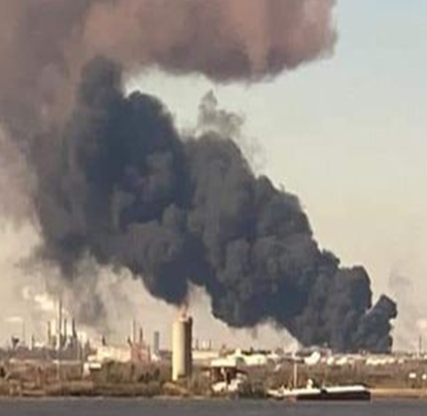
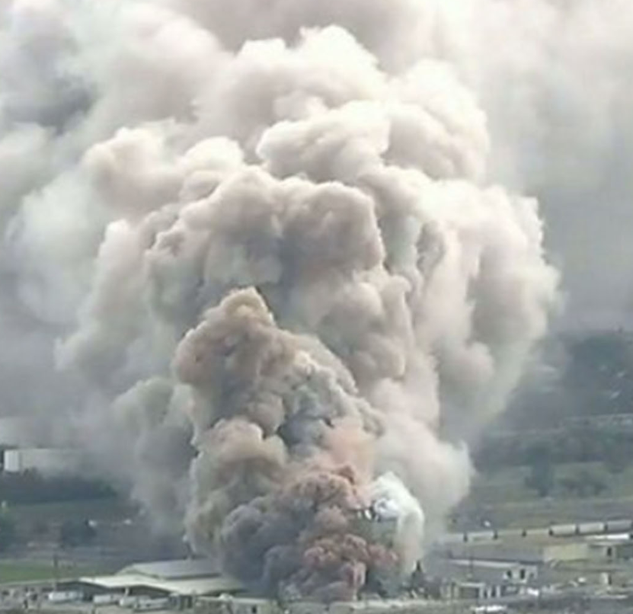
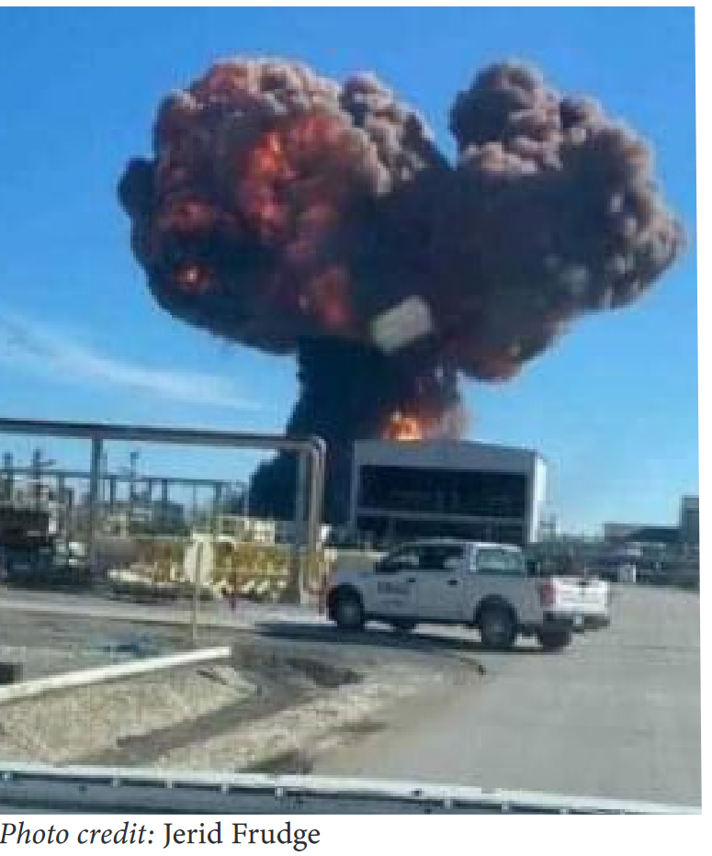
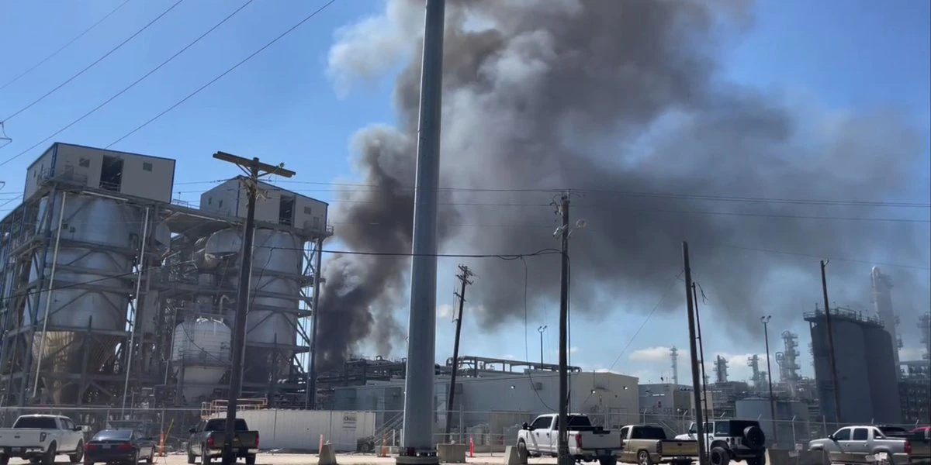
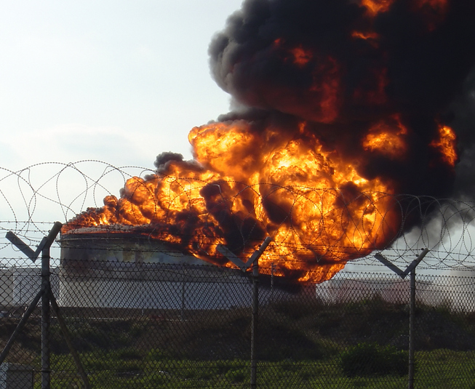
2024 Evaluation of Serious Accidental Releases 8/’20- 8/’23*
27 Incident Sources, Locations, and Pollutants
  18 Facilities (12 Chemical Mfg, 6 Petroleum Refineries)
  8 Parishes (40% in Calcasieu, 19% in Ascension)
Population Impacts
  >1,166,000 lbs Toxic Pollutants Released
  2 Deaths, 123 Hospital Visits
  16,700 Evacuated, >106,200 Sheltered in Place
18 Facilities Costs
  7 of 18 Facilities paid >$130 million in fines/penalties
  >$100 million in property damage/product loss
  27 Wrongful Death & Worker Injury Lawsuits
  >1,000 Residents Represented in Class Action Suits
*Evaluation performed by Vickie Boothe, Rosane Archery-McGowan, Greg Gasperecz, Scott Eustis
11
Notes:
It is also important to consider the systems’ price tag to the costs of not having them. This slide documents the severe and unsustainable health and financial costs to residents, workers, and the industry’s financial bottom line. Specifically, a 2024 Evaluation found 27 serious accidental releases which occurred between Aug 2020 and Aug 2023 at 18 facilities within 8 Parishes resulted in local residents including thousands of school children being exposed to more than 1.1 million lbs of toxic chemicals, 2 reported deaths, 123 confirmed hospital visits, 16,7000 resident evacuations and >106 thousand residents ordered to shelter in place. Cost to industry were also severe with 7 of the 18 facilities paying >$130 million in fines and suffering losses of more than$100 million in property damage and product loss. Additionally, workers have filed at least 27 wrongful deaths and injury lawsuits and more than 1,000 of residents are currently being represented in Class Action suits.

Slide 12
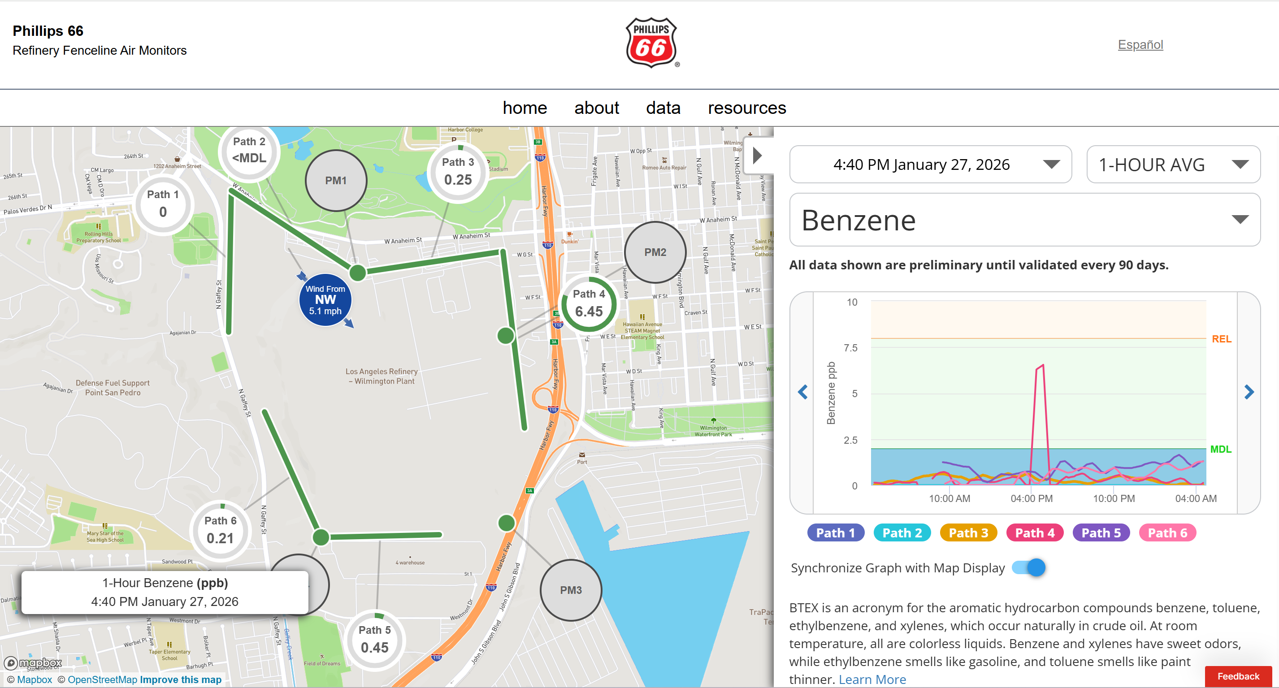
Phillips 66 Real-time Monitoring Data Display
12
Notes:
Now I want you to imagine how those unsustainable could have been prevented or reduced had residents and local officials been able to view any time day or night a website such as this one for a CA Phillips 66 refinery in the Los Angelos area. Since 2017, all 17 CA refineries have been required to install real-time fenceline monitoring and alert systems. This Los Angeles Phillips 66 Petroleum Refinery website displays fenceline benzene concentrations along 6 open paths on a map as well as on the graph. You can see on Jan. 27 between 4-5pm, a fugitive emission release caused Path 4 concentrations on the eastern property boundary to rise to 6.45 ppb, which is very close to the alert Reference Exposure Level of 8ppb. Had the concentrations risen above the 8 ppm REL an automated alert would have been generated and sent out.

Slide 13
SB356 SUMMARY points
13

Slide 14
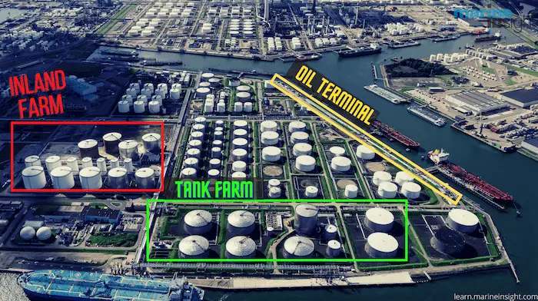

SB356 Real-time Fenceline Monitoring/Alert System Legislation
SB356 Objectives
  Evidence-based, protective, and cost-effective legislation
  Targeted at LA’s highest risk industrial pollutants & facilities
  Helps Parish Officials, first responders prevent/mitigate impacts
  Provides residents with real-time accurate information, early warnings
Compared to 2023 SB-35, SB356
  Reduces Covered Pollutants from 235 to 17 most toxic (93%)
  Reduces Covered Facilities from 476 to 117 highest risk (75%)
Reduces Industry Costs
  Enables real-time leak detection & faster repair
  Reduces worker deaths/injuries, property damage, product loss
  Prevents EPA & OSHA violations, penalties
  Reduces lengthy, expensive class action and worker lawsuits
14
Notes:
SB356 is evidence-based and designed to be cost-effective, and protective, especially for workers, first responders, and local residents. Compared to 2023 SB-35 and other previous bills, the proposed legislation targets the highest risks, reducing the number of covered pollutants by 93% from 235 to 17 and the # of covered facilities by 75% from 476 Major Title V facilities to the highest risk 117 refineries and chemical manufacturers. The proposed legislation also reduces industry cost by enabling faster leak detection and repair and reducing product loss, property damage, worker injuries and deaths and associated lawsuits and fines.

Slide 15
Extra Slides
16

Slide 16
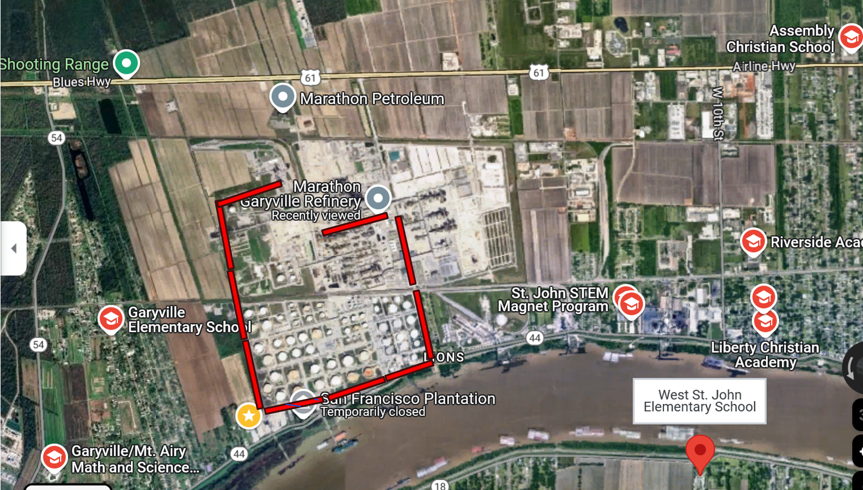
Marathon Garyville (3rd Largest US Refinery)
08/25/2023 96-hr Fire Impacts
  >48,000lbs pollutants released
  >8,000 residents exposed
  >2,800 residents evacuated
  29 residents treated at hospitals
  5 Class Action Suits
Monitoring/Alert System Costs
10 Open Path Monitors
  $628,500 Capital
  $65,000 Annual Maintenance
Marathon Revenue
2023 Earnings: $9.7 billion
ITEP ’98-’23: $9.1 billion
  Annual Avg: $364 million
24
Notes:
Again, Fenceline monitoring could have prevented most if not all of the impacts which included release of >48,000 pound……All at a cost of just over 600,00 capital and 65,000/year, which is literally a rounding error of Marathon’s annual tax exemptions.

Slide 17
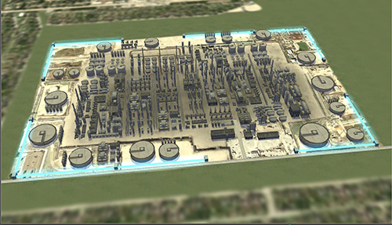
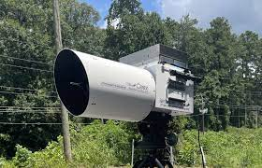
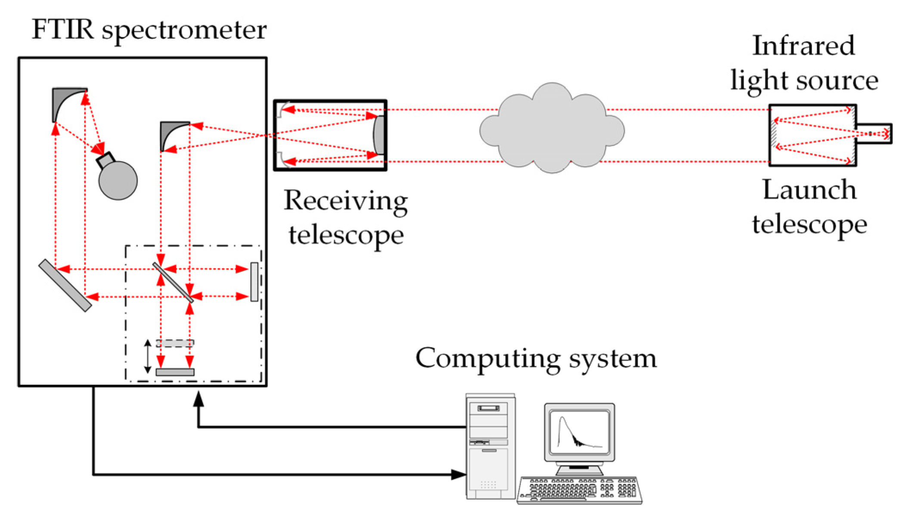
EPA-Recommended Real-time Fenceline Monitoring System Cost
UV Differential Optical Absorption Spectroscopy (UV-DOAS)
  Uses ultraviolet light beam to detect pollutants (up to 1,000 m)*
    High benzene sensitivity, recommended for refineries
  Capable of simultaneously measuring 20 pollutants
  Average Costs $250,000 - $628,500 Capital, $25,000 Annual**
    4 - 10 monitors & equipment shelters, data logger, weather station
Open-Path Fourier Transform Infrared Spectroscopy (OP-FTIR)
  Uses infrared light beam across an open path (up to 700 m)*
  Capable of simultaneously measuring > 100 pollutants
  Average Costs $150,000 - $300,000 Capital, $24,000 Annual*
    4 - 6 beam-detector systems, equipment shelters, data logger, weather station
Data Dissemination Website & Real-time Alert System
  Costs: $2,000 - $3,500/facility Capital, $40,000 Annual**
*Schill SR et al. Real-World Application of Open-Path UV-DOAS, TDL, and FT-IR Spectroscopy for Air Quality Monitoring at Industrial Facilities. Spectroscopy Supplements. Nov. 1, 2022
* *Mitro T. Santa Barbara APCD Proposed Staff Report for: Rule 364 Refinery Fenceline and Community Air Monitoring. 2020
19
Notes:
.FTIR Relatively low instrument cost (about $80,000 - $125,000) Low-cost long-term deployment (EPA Handbook: Optical and Remote Sensing for Measurement and Monitoring of Emissions Flux of Gases and Particulate Matter)

Slide 18
Louisiana 2026 Final List of Covered Pollutants
Real-time Alert System Notification
  Generated when concentrations exceed health-based thresholds (RELs)
  Distributed to facility, first responders, local officials, residents
    Opt-in texts, emails, or phone calls
Existing State and Local thresholds
  Based on Reference Exposure Level (REL)
    Level with no expected adverse health effects
2 Types of REL Exposure Duration
  Acute 1-hour exposures
  Chronic continuous long-term exposures (12 months)
Louisiana Fenceline Monitoring 17 High Risk Pollutants
Pollutant | Acute (1-hr) Threshold (μg/m3) | Chronic (12-month) Threshold (μg/m3)
Ammonia* | 3,200 | 200
Benzene | 27 | 3
1,3-butadiene | 660 | 2
Chlorine* | 210 | 0.2
Ethylbenzene | ----- | 2,000
Ethylene Dichloride | ----- | 400
Diethanolamine | ----- | 3
Ethylene Oxide | ---- | 30
Formaldehyde | 55 | 9
Hydrogen Cyanide | 340 | 9
Hydrogen Fluoride | 240 | 14
Hydrogen Sulfide | 42 | 42
Naphthalene | ---- | 9
Sulfur Dioxide | 660 | ----
Toluene | 37,000 | 300
Vinyl Chloride | 180,000 | ----
Xylenes | 22,000 | 700
* Added based on LA’s serious chemical release incidents

Slide 19
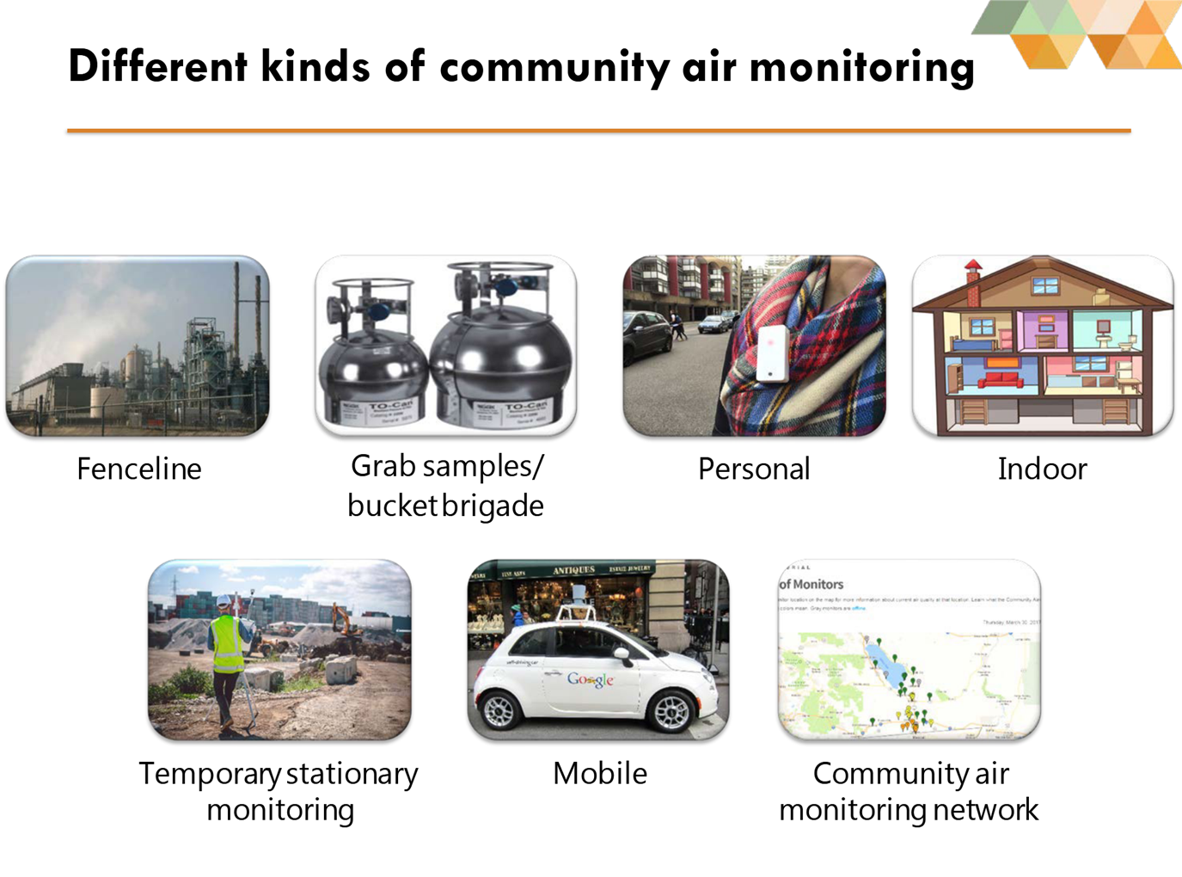
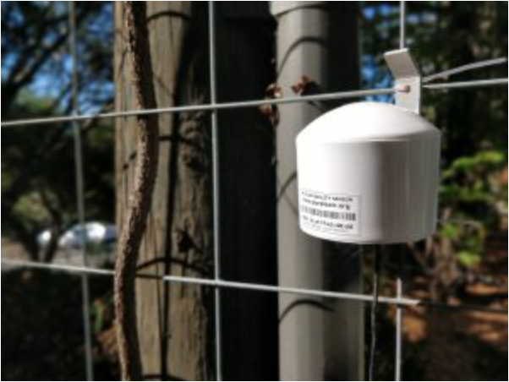
Community Air Monitoring
Definition: Local-level, often citizen-led, effort to measure, track, and understand air pollutants in specific neighborhoods, industrial zones, or near sensitive sites
PurpleAir
7
https://asic.aqrc.ucdavis.edu/sites/g/files/dgvnsk3466/files/inline-files/ASC%20Community%20Air%20Monitoring%20Networks%20-%20Final%20slides_0.pdf

Slide 20
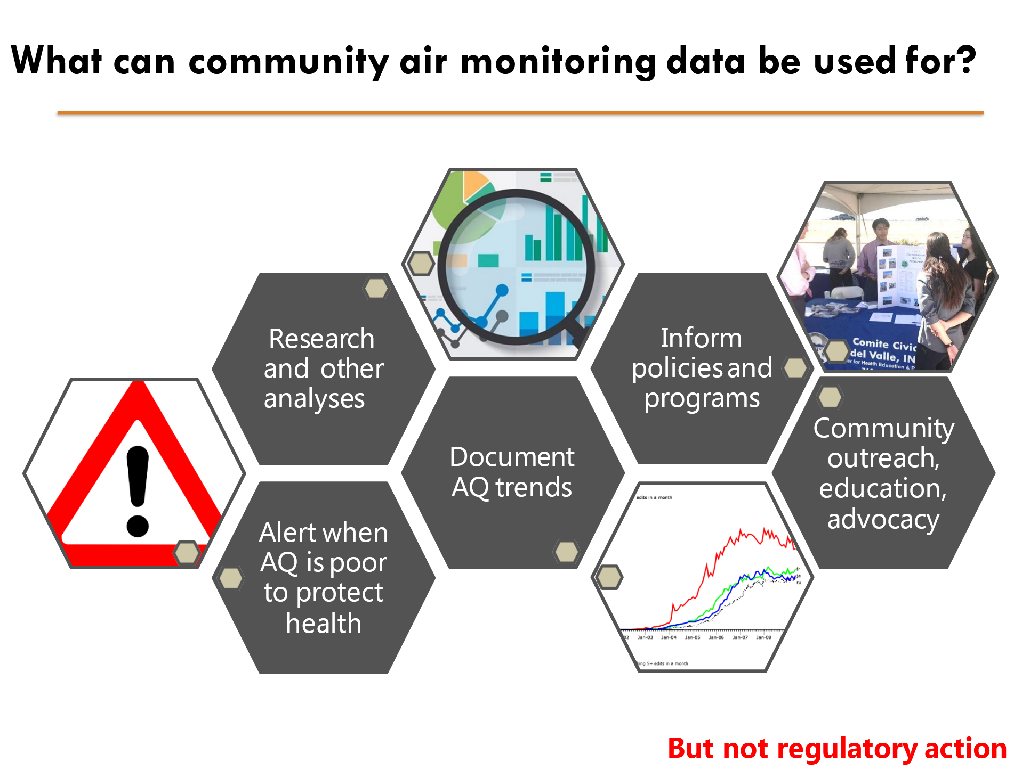
8

